Slide 1

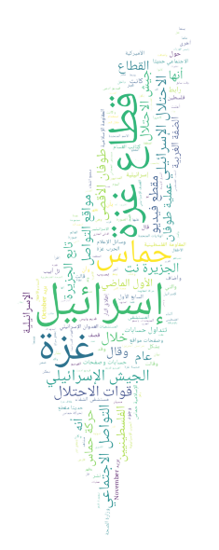
Fake News Classification
in Palestine Using
ML & NLP
Group C
presteted to:
DR TAREQ ALTALMAS
16 MAY 2025

Slide 2

Content
01
02
03
04
05
06
07
Introduction
Dataset & Preprocessing
Feature Extraction & Engineering
Exploratory Data Analysis (EDA)
Model Selection & Performance
Results & Testing
Conclusion & Recommendations

Slide 3
Introduction
Fake news spreads rapidly on social media, causing confusion and harm.
Objective: Build a machine learning model to classify Arabic news as real or fake.
Approach: Use Natural Language Processing (NLP) and machine learning techniques.

Slide 4
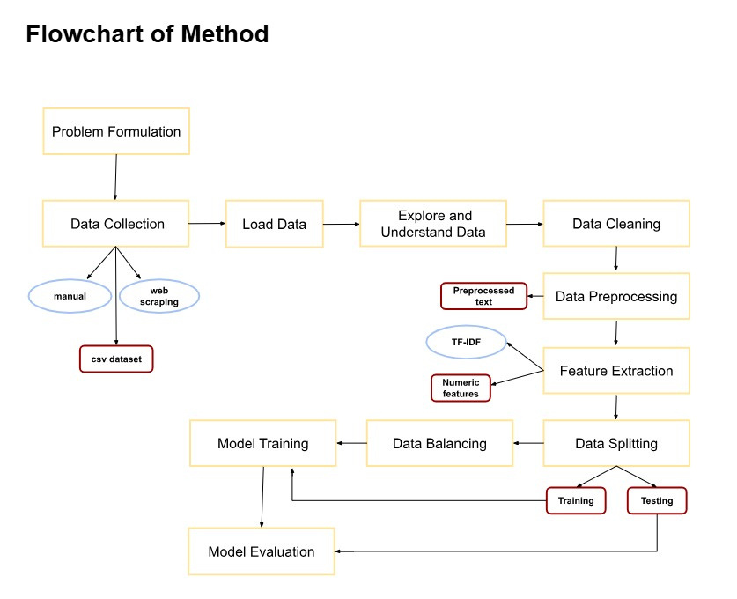
Flowchart of Methods

Slide 5
DATASET OVERVIEW
COLUMNS: ID, TITLE, TEXT, PLATFORM, LABEL (REAL/FAKE).
CHALLENGES:
UNBALANCED DATASET (MORE REAL ARTICLES).
INCONSISTENT PLATFORM NAMES (E.G., AFP VS. AFP FACT CHECK).
INCORRECT VALUES IN THE PLATFORM COLUMN (REMOVED).
SOLUTION: APPLIED BALANCING TECHNIQUES AND DATA CLEANING.

Slide 6
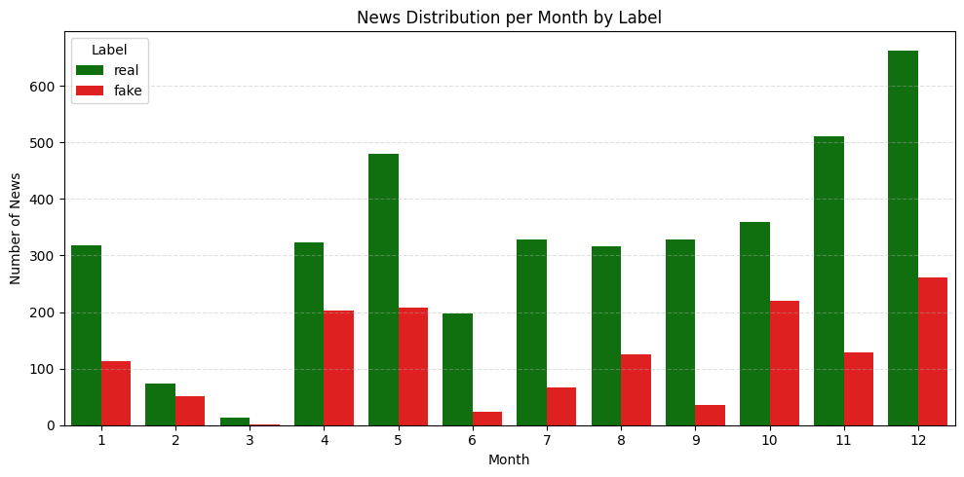
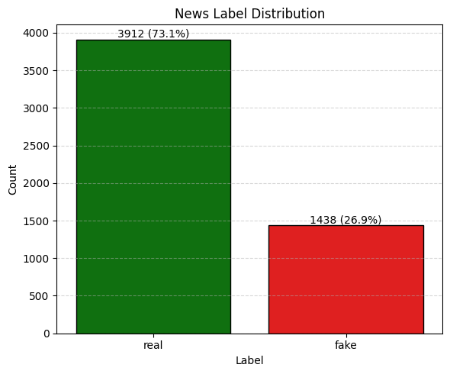
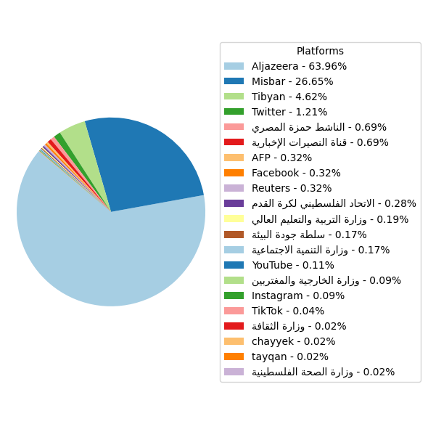
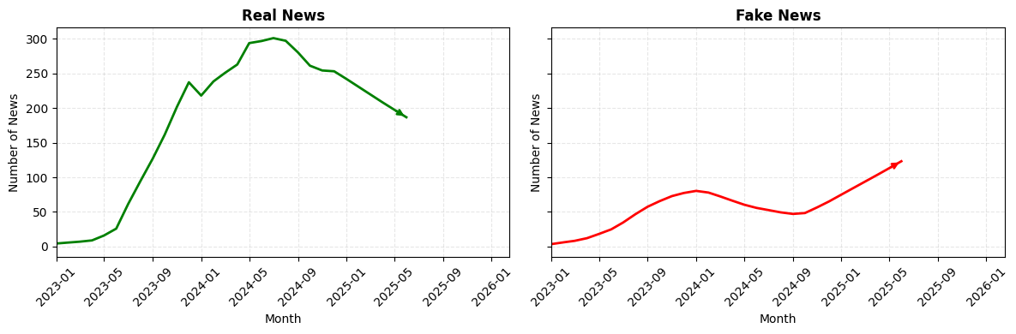
Exploratory Data Analysis (EDA)

Slide 7
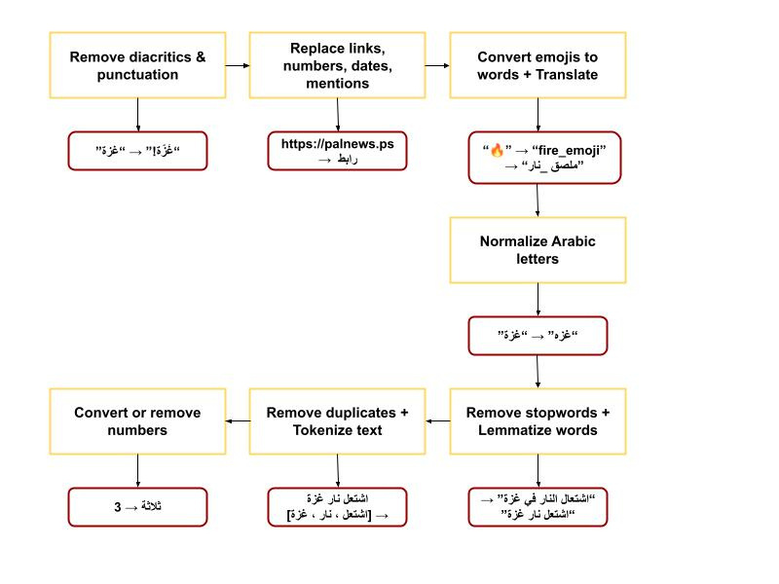
Data Preprocessing

Slide 8
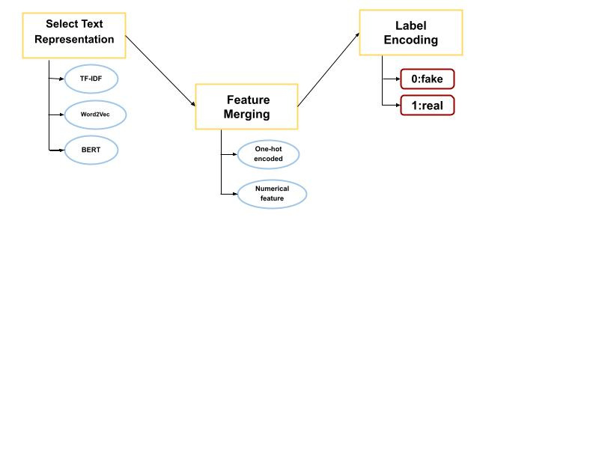
Feature Extraction & Engineering

Slide 9
Model Selection
Tested models: Logistic Regression, SVM, Naive Bayes, Random Forest, and XGBoost.
Feature sets: TF-IDF, Word2Vec, AraBERT embeddings + platform/numerical features.
Best performer: XGBoost with TF-IDF (Text + Platform).
Accuracy: 95.05%.
Balanced F1-scores for fake and real news.

Slide 10
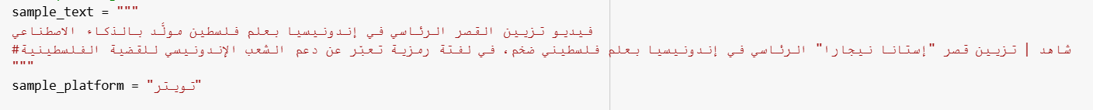
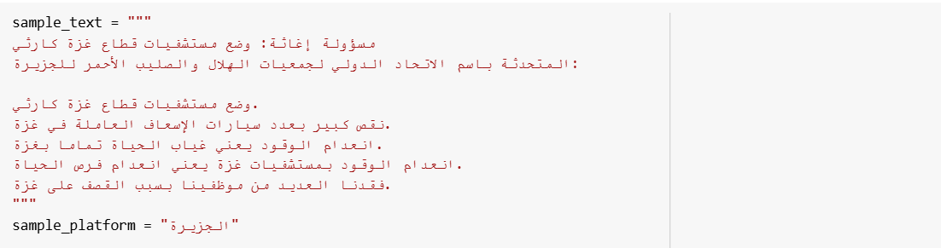
Results
Sample 1 (Fake): Correctly predicted.
Sample 2 (Real): Correctly predicted.

Slide 11
Conclusion & Recommendations
Built a robust model for Arabic fake news detection (95% accuracy).
Recommendations:
Use larger, more diverse datasets.
Explore deep learning models.
Analyze emotional tone and emojis.
Classify fake news into detailed categories.

Slide 12
Thank you !

